Slide 1
Projekt EFFeCT

Slide 2
projekt EFFECT
Kulaty STUL, NIDV: 16. dubna 2018
http://oktataskepzes.tka.hu/en/effect-project

Slide 3
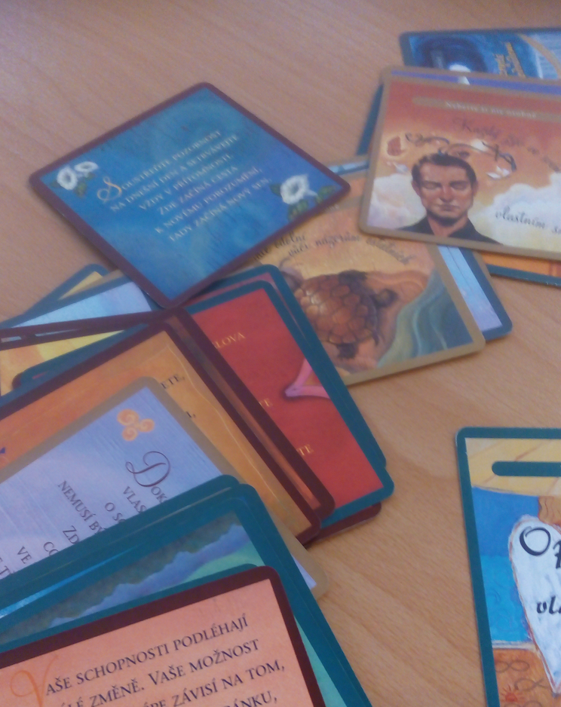
INTRODUCTION TO EFFECT PROJECT & Concept ctL …
examples from range of practices
SOME findings/results
implications & discussion
OUTLINE

Slide 4
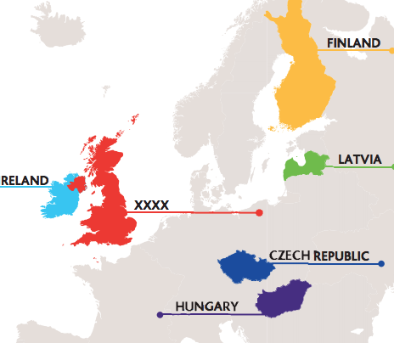
THE EFFECT PROJECT:
European Methodological Framework for Facilitating Collaborative Learning for Teachers
European Methodological Framework for Facilitating Collaborative Learning for Teachers’
 | Organisation | Organisation
KDO? | Tempus Public Foundation, Hungary - Co-ordinator | Faculty of Education, University of Jyvaskyla, Finland
 | University of Hertfordshire, England | Mary Immaculate College, Ireland
 | Valsts izglitibas satura centrs (NCfE), Latvia | NIDV, Czech Republic
KDY: listopad 2015 - duben 2018

Slide 5
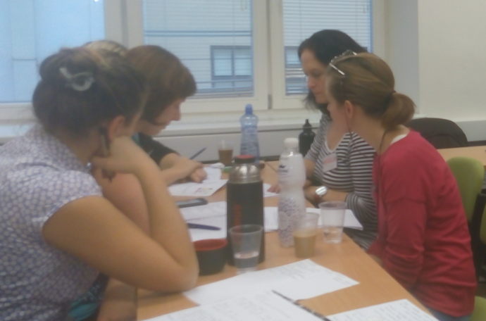
Aim of the Project “EFFECT”
to design a methodological framework
and to disseminate the same by means of
an e-publication on which
teachers’ professional collaborative learning
might be initiated and
then might be built.

Slide 6
The focus - benefits of collaboration
The focus for the EFFeCT project is teachers’ professional learning and the means by which benefits may be gained through collaboration with other teachers and other educators.
By ‘professional learning’ may be understood that which a teacher acquires arising from direct and indirect (first-hand or second-hand) experience and on which basis that teacher then applies to her/his knowledge and understanding in relation to her/his professional practice.

Slide 7
context
21st Century key skills for all:
Communication, Critical Thinking, Collaboration, Creativity & Innovation
Vangrieken et al. (2015) “effective collaboration … has vital importance for the future as it is needed to build schools into learning organisations, to anticipate the growing importance of collaboration in society and to use education as a role model for students to properly prepare them for the future.”
In schools where teachers collaborate, student test scores improve.
“Teachers who work together in a meaningful and purposeful way have also been found to be more likely to remain in the profession because they feel valued and supported in their work.” (Mulford, 2003)

Slide 8
New (2018) European Commission Document

Slide 9
CONCEPT
A methodological framework is
(i) an “approach for making explicit and structuring how a given task is performed”and
(ii) a “set of structured principles”.
Collaboration for teachers is “working together, towards a shared vision of purpose
and outcome for personal, professional or system-wide benefit.” (Bell, 2015)
Collaborative teacher learning (CTL) is teachers working together,
purposefully interacting and
is intended to advance teachers’ learning,
based on participative and inclusive values and
with a commitment to co-construction of professionally-related concepts and
ways of understanding and of practising their profession.

Slide 10
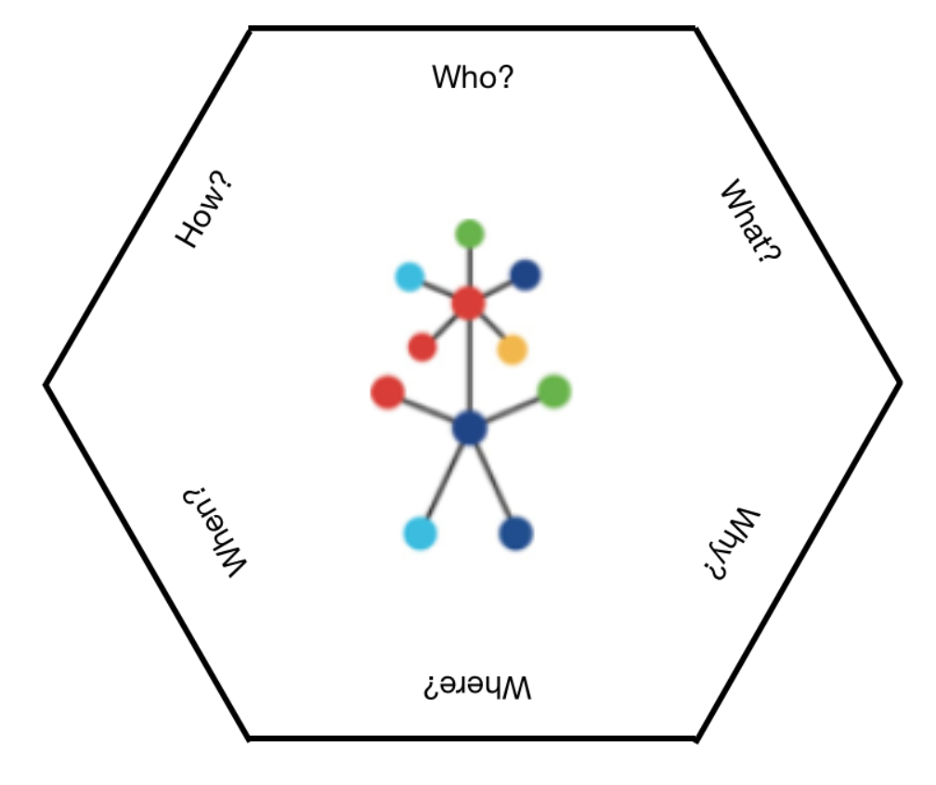
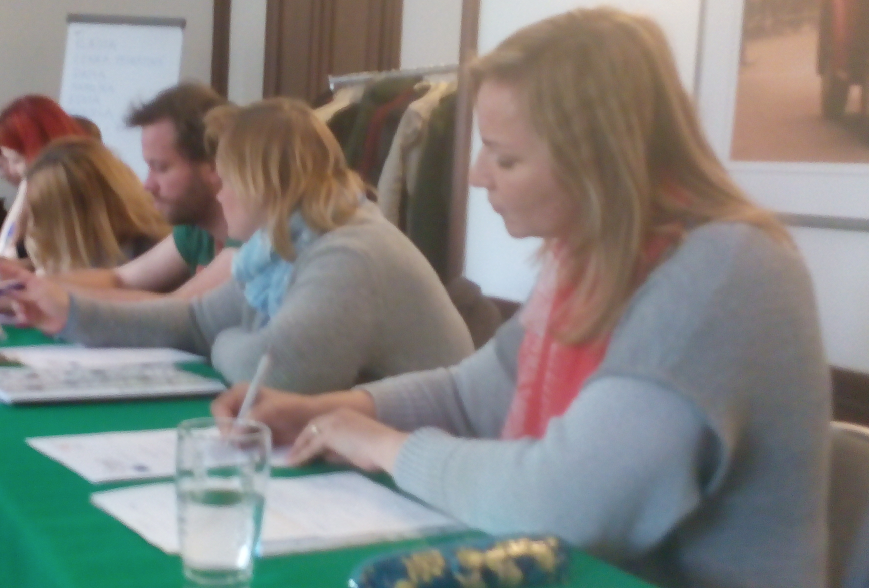
?

Slide 11
examples of good practice
Focus | Focus
Activity-Centred Education | Education for Democracy
Headteacher & Leadership Development | Languages’ Teaching: Content and Language Integrated Learning CLIL
Literacy Combatting Social Deprivation | Peer Group Mentoring
Raising Student Achievement University Schools Network | Teacher Learning Communities & Networks
Unity Network Higher Education | Working with the Community

Slide 12
mentor learning from facilitator
GROW G.R.O.W. Goal. Reality. Options. Will.
SMART[ER] S.M.A.R.T.(E.R.)
MENTORSKY STUL MENTOR TABLE
BALANCNI KOLO BALANCE WHEEL
ZPETNA VAZBA: VIDIM A SLUSIM FEEDBACK: I OBSERVE AND LISTEN
MENE JE VICE LESS IS MORE
ZADNA OTAZKA NENI SPATNE NO SUCH THING AS A SIMPLE QUESTION
OTREVRENE SILNE OTAZKY OPEN AND STRONG QUESTIONING
NALADENI NA MENTEE BE ON THE MENTEE’S WAVELENGTH
POSITIVNI NALADENI FINE TUNING
FORMA A OSNOVA FORM AND STRUCTURE
NAS PECI LOOK AFTER / TAKE CARE of OWN HEALTH
PLANOVANI PLANNING
SPETNA VAZBA FEEDBACK
UMRIMIVOST MODERATION
MENTORSKY DENIK MENTOR’S DIARY

Slide 13
mentor learning from OTHER MENtorS
UZITECNOST SDILENI BENEFITS OF SHARING
NASLOUCHANI DRUHEMU LISTENING TO OTHERS’ PERSPECTIVES
VIRA JE SMYSL MENTORINGU FAITH IN THE MENTORING CONCEPT/
BELIEF IN THE VALUE OF MENTORING
INSPIRACE ODDENIM PRIBEHY INSPIRATION FROM DIFFERENT STORIES/
RUZNE UHLY POHLEDU DIFFERENT VIEWPOINTS
NEHODNOTIM ≥ PODPISU HAVING TO SIGN WHEN THINGS ARE NOT GOOD
VETSI SEBEVEDOMI GREATER SELF-CONFIDENCE
TRENINK A ZDUSENI TRAINING AND GROWTH
DAVANI PROSTRORU GIVING MAKING SPACE (TO DO THE JOB)
VYSELCHNOUT A BYT EMOCNE PRITOMNY TO LISTEN AND TO STAY FOCUSSED
INVESTICE KVALITY INVESTING IN QUALITY
NEPRETRZITY PRIVES UCENI UNINTERRUPTED FLOW OF LEARNING
TOLERANCE TOLERANCE
TRPELIVOST PATIENCE
VEDENI PORTFOLIU PORTFOLIO
NEODKLADAT DELAT HNED DO NOT PROCRASTINATE
VSTUP DO OKRU ROST A STEP IN CAREER GROWTH

Slide 14
MENTOR LEARNING FROM MENTEES
NEVYZADANA RADA NEFUNGUJE UNREQUESTED ADVICE DOES NOT WORK
DUVERA TRUST
SPOLECNE RESENI MANAGING TOGETHER
NA CESTA UCIME S OBA ON THE JOURNEY WE LEARN TOGETHER
PREKRACOVAT NESNAZE TO FORESEE DIFFICULTIES
PECLIVOST, PRIPRAVA FOCUSSED PREPARATION
CHTENI ≥ MOTIVACE RELATIONSHIP BETWEEN DESIRE & MOTIVATION
MUJ POSUN MY MOVEMENT / GESTURES
POCTIVOST A SNAHA JSOU LEPSI HONESTY AND EFFORT ARE BEST
PROVOKACE ≥ SILNA OTAZKA SEARCHING (DEEPER) QUESTIONING LEADS
TO STRONGER INQUIRY (FOR NEW TEACHER)
SAMOSTATNOST INDEPENDENCE
ELAN ZACINAJICA VITALITY/ENTHUSIASM OF THE BEGINNER
ZBAVIL/A JSEM SE OSTYCHU FREEING MYSELF FROM SHYNESS
UZITECNOST BENEFICIAL EFFECT
VYSTOUPENI Z KONFOR ZONY GETTING OUT OF COMFORT ZONES
POTREBA PLANOVAT NEED TO PLAN

Slide 15
mentEE learning from facilitator
rhetoric, communication skills
I know what type of teacher I want to be (and if)
respect for the group
the importance of preparation
the mentor does not do all the work
methods that can be applied with my students
individualisation and relationship with students
feedback as help and support
applying SMART targets
the GROW process
the Balance Wheel
immediate sense of togetherness through joint practice
support for one’s own activities
time management
transfer methods to our personal lives/life
kindness

Slide 16
mentEE learning from MENtor
System for structuring lessons
Partnership (I can come up with anything)
Trust (I can say I was mistaken) to err is human
Positive energy
principle of dialogue; ways of communicating
close relationship
regular meeting
guiding practice to the final form
written feedback - not a criticism; a critique
mutual feedback
experiences, tips (methods & techniques)
to be balanced and have a healthy perspective
there is more than one way to do something and it is possible to choose
professionality / professionalism
it is possible to choose your own way.
Not directed but given choices
Revealing similarities

Slide 17
mentEE learning from MENTEES
advice, counsel
how to solve problems (in the coffee breaks)
How well the mentor and mentee got on.
sharing - I am not alone; not being perfect is normal.
discovering how things are done differently; how practice is in other places
making links and contacts and co-operation
refreshing/energising
mutual openness
discovering how things are done differently; how practice is in other places and in another type of school
It can be more difficult for others/ emerging sympathy and empathy
A safe place to alleviate worries

Slide 18
Dalsi
What we found interesting:
mentor table (See http://www.tikumu.co.nz/wp-content/uploads/2016/04/Mentors-table.pdf)
strong open questioning
less is sometimes more
written feedback
What pleased us
mentor/mentee learned with us
they had similar themes
high rating of trust
it is a journey together
Questions/observations
preference for non-directiveness
they solve similar things (shyness)
what is the mentor table?
What made us amused
Unwanted advice does not work.

Slide 19
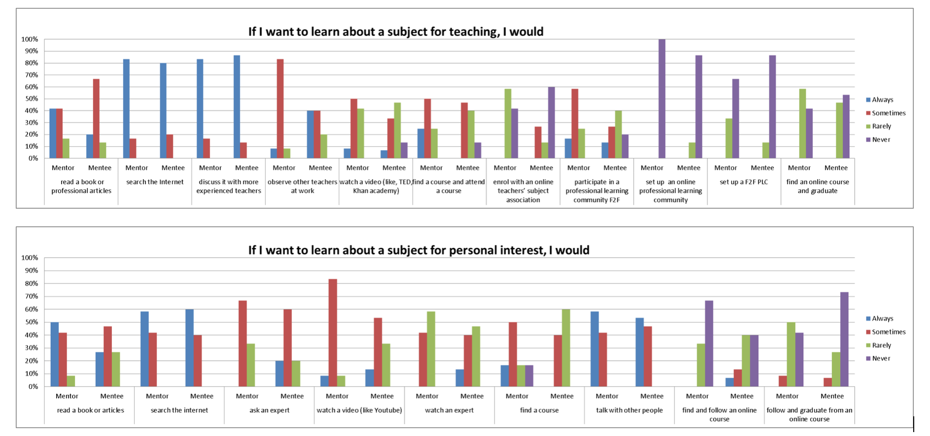
Learning approaches

Slide 20
implications for teachers
taking responsibility for personal professional development
taking part in and initiating professional dialogue
taking a leadership role
sharing ideas, listening and planning together
being prepared to challenge the status quo
being prepared to change beliefs and practice
being open to constructive feedback
being observed and observing
becoming a lifelong learner
introducing collaboration to students

Slide 21
implications for headteachers
Headteachers can model norms and behaviour that promote an environment where more collaborative teacher learning can occur.
Ideally, headteachers can set aside time and allocate resources that establish opportunities which enable teachers to work collaboratively.
As pedagogic leaders, headteachers can act as mentors and, as directors of staffing, also provide teachers with mentoring and ensure feedback to help them develop their skills.
Encourage new leaders to emerge and to distribute leadership roles.
.
Headteachers and other school leaders play essential roles in creating the conditions for meaningful collaboration among teachers and their learning.
Collaboration between schools requires thinking outside of the single institution but also requires joint planning at every level.
Create a culture of learning, sharing, co-planning, peer observation.
Headteachers, too, need to collaborate for their own professional learning.

Slide 22
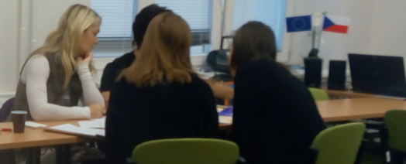
implications for CPD/CPL organisations & HE
Read Carl Rogers (1969) Freedom to learn”
Ratio of time of input by facilitators to be no more than 30%
Activity and sharing time for participants 70%
“Flipped Classrooms” approach
Increased use of technology - KISS (Keep it Simple Stupid)
short and regular meetings are better than one long session
recognise the expertise that lies within the learning group and allow it time
ensure that the space available is sufficient to support group interaction
make sure that breaks are long enough for informal ‘bonding’
collaborate with other organisations to provide highest quality learning opportunities
build in collaborative action research and action enquiry techniques
celebrate achievement

Slide 23
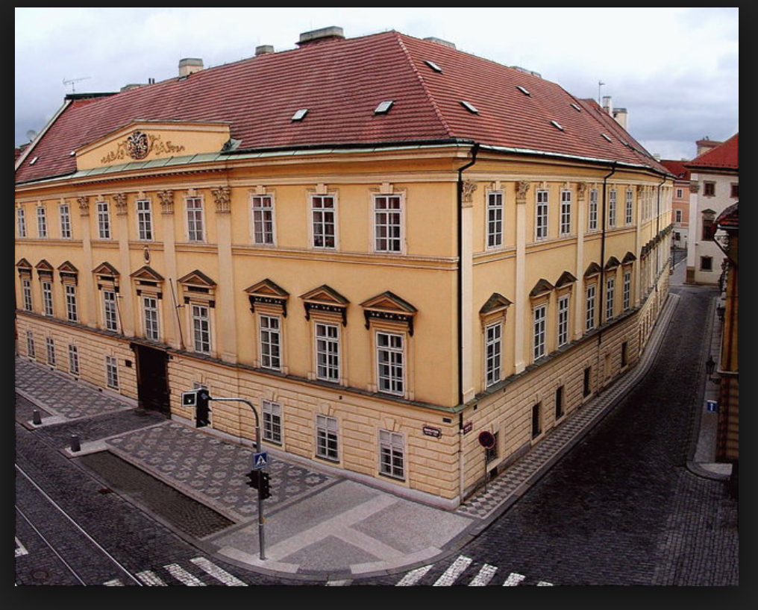
iMPLICATIONS FOR POLICY-MAKERS
Model collaboration and learning within the policy-making community.
National Teachers’ Contracts and Conditions of Service - establish professional learning time: minimum number of hours, days.
In planning the school year, establish common opportunities for collaboration between schools
Where there are inspections, recognise the value of collaboration as a feature of an effective school.
Establish a database of good practice and share this among schools and other educators
Support schools who seek to collaborate by adequately resourcing, for example, additional short-term funding, advice and, where necessary, specialist intervention from expert (CTL) staff to coach, monitor and mentor.
Harnessing the wisdom and opportunities at all levels through regular focussed local, regional and national: Headteacher forums, Middle Leader forums, Experienced Teacher forums, Newly-Qualified Teachers forums, (Teaching) Learning Assistants forums
Collaboration with and support for teachers subject or phase professional associations
Learning Repository where outcomes of collaborative educator learning are held and continually being supplemented
Supporting cross-phase collaboration which enhances student learning and raises the professional knowledge and understanding of colleagues in other phases.
Valuing and celebrating good practice in collaborative teacher learning in an annual ‘festival of learning’
Examine school architecture for opportunities to modify to allow innovative collaborative teaching and learning.
Build only new schools which serve team approaches, team-teaching and a creative curriculum, which develops both core and 21st century competency for the whole school community.
“Of the best leaders, they say we did it ourselves.” Lao Tse.

Slide 24
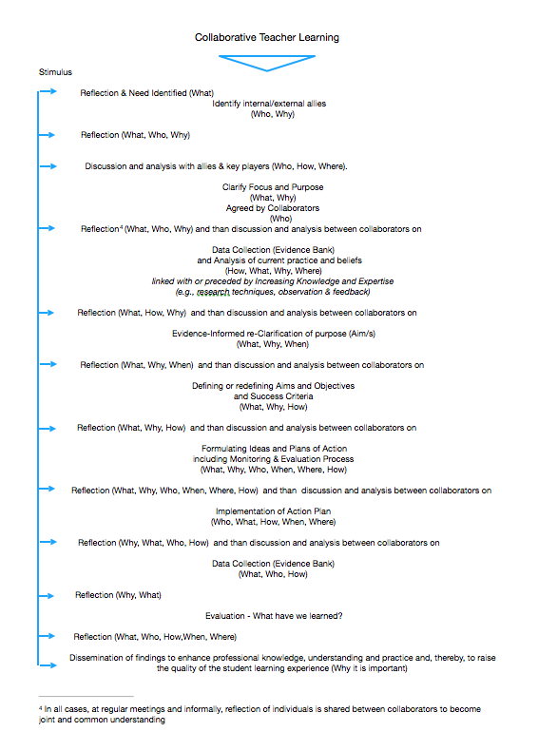

Slide 25
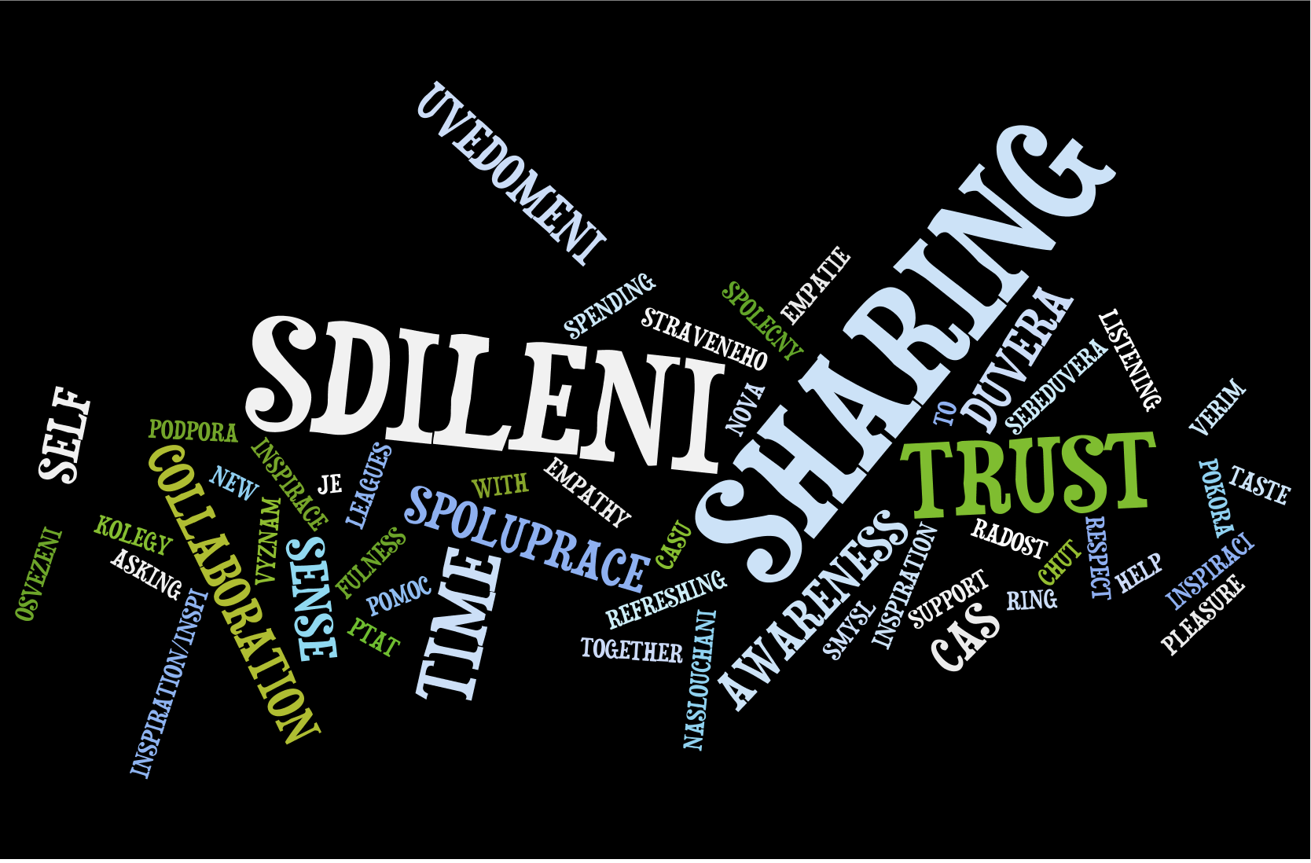
Last words from pilot group

Slide 26
Zpetna Vazba
Vážené kolegyně, vážení kolegové,
byli bychom vděčni, pokud byste mohli přispět k evaluaci projektu EFFeCT tím, že vyplníte tento krátký dotazník. Při publikování a šíření výsledků nebudou zveřejněny individuální údaje.
Dear Colleagues,
We would be grateful if you could contribute to the evaluation of the EFFeCT project by completing this short questionnaire. No individual data will be published when publishing and disseminating the results.

Slide 27
Zpetna Vazba
Vidíte ve spolupráci mezi mentorem (uvádějící učitel) a mentee (začínající učitel) kvalitativní posun? Jaký? Do you see a qualitative shift in co-operation between mentor (teacher) and mentee (starting teacher)? What?
A.Obě paní kolegyně, účastnice projektu, se posunuly v tom, že si osvojily dovednosti potřebné k fungování vztah mentor – mentee. Podle jejich slov se jim daří pojmenovávat správně to, co chtějí řešit, učily se , jak zvolenou oblast své společné práce řešit. V tomto směru došlo k posunu během práce v projektu.
B. Ano, otevřenější komunikce, pomáhá sdílení metody, znalost postupu, struktura diskuze
C. ANO:YES Odborný růst obou účastníků. Stanovování a uvědomění si jasných cílů osobního rozvoje. Hledání cest realizaci, vyhodnocování této cesty
D. Spolupráce mezi novým a uvádějícím učitelem u nás byla vždy. Ale díky Vašemu projektu jsme techniky mentorování více prohloubili.
E. Jejich spolupráce je kvalitnější, setkávají se pravidelně, účast v projektu přinesla rozšíření vzájemné spolupráce, která dříve probíhala spíše náhodně. .
F. Lepší zacílení na konkrétní problém, jak ze strany M, tak ze strany MEE a efektivnější způsoby řešení v praxi. Jasnější nastavení cílů.

Slide 28
Zpetna Vazba
2. Jaký přínos pro Vaši školu mělo využití mentoringu? What benefit did mentoring have for your school?
A. Konkrétní práce obou kolegyň zapojených v projektu Effect má význam zejména pro ně samé, pro jeich osobní rozvoj. Pro školu má význam využití mentoringu v případě, že se podaří nastavit systém podpory jednotlivých pedagogů, systém, v rámci kterého si budou mít jednotliví členové pdg. sboru šanci říci o podporu, pokud budou mít pocit, že ji potřebují.
B. Paní Mgr. …ova, která absolvovala program projektu Effect, má ve škole funkci metodika pro rozvoj čtenářství, účast v projektu jí pomůže k tomu, aby funkci metodika v práci s jednotlivými učiteli mohla realizovat na vyšší úrovni. + Zavedení systému práce se začínajícími učiteli
C. Ve škole vedení lidí formou mentoringu dlouhodobě funguje. Projekt pomohl a zkvalitnil tuto podporu pedagogům.
D. Projekt Effect - mentoring svým zaměřením nabízel možnost rozvoje mentorských kompetencí především pro učitele kolektivních předmětů. Individuální spoluprácí s lektory, jejich ochotou zohlednit i specifické prostředí základního uměleckého školství bylo však možno získat cenné zkušenosti i jako učitel individuální výuky. Největším přínosem je jednoznačně spolupráce s ostatními učiteli, sdílení zkušeností, nápadů a postřehů, případné navázání další spolupráce.
E. Mentee se posunul v konkrétní zadaném úkolu, na kterém s mentorem pracovali. Je si jistější ve své práci, podporu mentora vnímá jako přínos a chtěl by ji dále využívat.
F. Otevřelo debaty na téma vzdělávání – přístupy učitele k žákům, uplatnění některých principů mentoringu ve výuce, ale i ve spolupráci v ped. sboru.

Slide 29
Zpetna Vazba
3. Jaké kroky jste podnikli na Vaší škole pro podporu kolaborativního učení, tedy učení se navzájem? What steps have you taken in your school to promote collaborative learning, that is learning from and with each other?
A. V rámci fungování celého pedagogického sboru a předmětových komisí připravují pedagogové společné vzdělávání v oblasti metodiky výuky – jedná se zejména o společné vzdělávání se v oblasti etické výchovy, metodiky výuky tv, matematika Hejného, rozvoj čtenářské gramotnosti, rozvoj počítačové gramotnosti – využití didaktické techniky ve výuce, vždy někdo ze sboru vede program pro ostatní. Kromě seminářů máme nastavený systém vzájemných hospitací, opět slouží k tomu, aby kolegové sdíleli zkuěšenosti,
B. Vzájemné návštěvy učitelů v hodinách.
C. Ve škole vedení lidí formou mentoringu dlouhodobě funguje. Projekt pomohl a zkvalitnil tuto podporu pedagogům.
D. Intenzivnější schůzky daných oddělení, větší podpora ze strany vedení.
E. Vzájemné pravidelné schůzky učitelů jednotlivých ročníků a předmětů, vzájemné návštěvy v hodinách, otevřené hodiny pro kolegy, práce uvádějících učitelů, schůzky mentorů.
F. Učitele si navzájem „otevřeli“ dveře svých tříd pro návštěvy svých kolegů. Zavedli jsme dobrovolné hospitace – pozvi mě do hodiny, přijdu se rád podívat….

Slide 30
Zpetna Vazba
4. Jaké změny jste zavedli nebo v budoucnu zavedete v praxi své školy v souvislosti s kolaborativním učením? What changes have you introduced or will you put into practice in your school practice in the context of collaborative learning?
A. Budeme hledat zejména finanční možnosti, jak se zařadit do práce školy párové vyučování. Budeme hledat finanční prostředky, abychom mohli organizovat podporu pdg. sboru prostřednictvím externích mentorů, dalším krokem by měla být podpora interního mentoringu – vzdělávání v to oblasti, vytvoření prostoru pro tuto činnost (úleva v přímé pdg. činnosti pro mentorskou činnost…)
B. Chtěli bychom postupně se dostat k párovému učení..
C. Ve škole vedení lidí formou mentoringu dlouhodobě funguje. Projekt pomohl a zkvalitnil tuto podporu pedagogům.
D. Budeme neustále prohlubovat ☺
E. Úprava rozvrhů pro mentory, snížení počtu vyučovacích hodin, předávání zkušeností mentorů i mentee ostatním kolegům, pravidelné schůzky mentorů a vedení školy, proškolení dalších mentorů.
F. Od nového školního roku: 1x za čtvrtletí v rámci pg. rad – sdělování a předávání zkušeností a tipů do výuky s asistencí mentora (cíle + vyhodnocení)
G. Děkuji celému týmu, který projekt připravil – byl to velmi cenný přínos do pedagogické praxe, s přesahem do efektivního vedení lidí ve školství.

Slide 31
Learning for the facilitator from CARL ROGERS
The Role of the facilitator of learning
Facilitators need to bear in mind the words of Carl Rogers, educator extraordinaire.
Rogers’ 10 basic assumptions
Human beings have a natural potentiality for learning.
Significant learning takes place when the subject matter is perceived by the learner as having relevance for his/her own purposes.
Learning which involves a change in self organisation–in the perception of oneself–is threatening and tends to be resisted.
Those learnings which are threatening to the self are more easily processed and assimilated when external threats are at a minimum.
When threats to the self are low, experience can be perceived in a differentiated fashion and learning can proceed.
Much significant learning is acquired through doing.
Learning is facilitated when the learner participates responsibly in the learning process.
Self–initiated Learning which involves the whole person of the learner – feelings as well as intellect – is the most lasting and pervasive.
Independence, creativity, and self-reliance are all facilitated when self-criticism and self-evaluation our basic and evaluation by others is of secondary importance.
The most socially-useful learning in the modern world is the learning of the process of learning, a continuing openness to experience and incorporation into oneself of the process of change.
(NB I have changed references to ‘students’ and inserted ‘learner’ and included ‘her’.)

Slide 32
ROGERS (2) lessons for facilitators
Within the framework of advancing CTL, the role of facilitator (which among peers, that is, co-educators, might transfer knowledge not only between meetings - as practised among the project partners - but also within meetings to achieve the purpose for meeting) is important.
The facilitator has much to do with setting the initial mood or climate of the group … experience.
The facilitator helps to elicit and clarify the purposes of the individuals … as well as the more general purposes of the group.
(S)He relies upon the desire of each learner to implement those purposes which have meaning for (her)him, as the motivational force behind significantly learning.
(S)He endeavours to organise and make easily available the widest possible range of resources for learning .
(S)He regards (her)himself as a flexible resource to be utilised by the group.
In responding to expressions in the classroom group, (s)he accepts both the intellectual content and the emotionalised attitudes, and gathering to give each aspect the approximate degree of emphasis which it has for the individual or the group.
As the acceptant classroom climate becomes established, the facilitator is able increasingly to become a participant learner, a member of the group, expressing (her)his views as those of one individual only.
(S)He takes the initiative in sharing himself with the group – (her)his feelings as well as (her)his thoughts – in ways which do not demand or impose but represent simply a personal sharing which students (others) may take or leave.
Throughout the classroom experience, (s)he remains alert to the expression indicative of deep or strong feelings.
In (her)his functioning as a facilitator of learning, the leader endeavours to recognise and accept her/ his own limitations.

